Slide 1

Brand Marketing Strategy for Mobile Phone Companies

Slide 2


Who are my customers ?
What are their preferences ?
Market brand positioning ?
When to launch a new product ?
What price to launch a new product ?
Who are the Loyal customers ?

Slide 3

Brand Positioning
Competitor Analysis
National And International
N
Brand Value/Loyalty
Brand Key Drivers
Commodity
Strategy
Brand Compass
Customer
Weather
W
E
Economic
Customer description
Target Customer
Brand Pricing
Channel
Price
S
Social and cultural
Customer Description
Customer Preference
Notes:
Important Factors That Influence The Buying Decision
1. Economic Factor
The most important and first on this list is the Economic Factor. This one is the main foundation of any purchasing decision. The reason is simple people can’t buy what they can’t afford. The need of a product also doesn’t play a role here, but the most important thing is affordability.
2. Functional Factor
The factor is totally about needs, backed by a logic that what makes sense and also fits in the best interest of the customer. This one factor also plays a very important role in the buying decision.
3. Marketing Mix Factors
There are 4 components in the marketing mix, i.e. product, pricing, promotion and place of distribution and each of these components have a direct or indirect impact on the buying process of the consumers. The consumers consider various things like the characteristics of the product, price charged, availability of the product at the required location and much more.
4. Personal Factors
The personal factors include age, occupation, lifestyle, social and economic status and the gender of the consumer. These factors can individually or collectively affect the buying decisions of the consumers.
5. Psychological Factor
When it comes to the psychological factors there are 4 important things affecting the consumer buying behaviour, i.e. perception, motivation, learning, beliefs and attitudes.
6. Social Factors
Social factors include reference groups, family, and social status. These factors too affect the buying behaviour of the consumer. These factors in turn reflect an endless and vigorous inflow through which people learn different values of consumption.
7. Cultural Factors
Cultural factors have a subtle influence on a consumer’s purchasing decision process. Since each individual lives in a complex social and cultural environment, the kinds of products or services they intend to use can be directly or indirectly be influenced by the overall cultural context in which they live and grow. These Cultural factors include race and religion, tradition, caste and moral values

Slide 4


KPI
Product Launch
Marketing Strategy
Right Product Mix
Right Time
Right Customers

Slide 5

Who are my customers ?

Slide 6
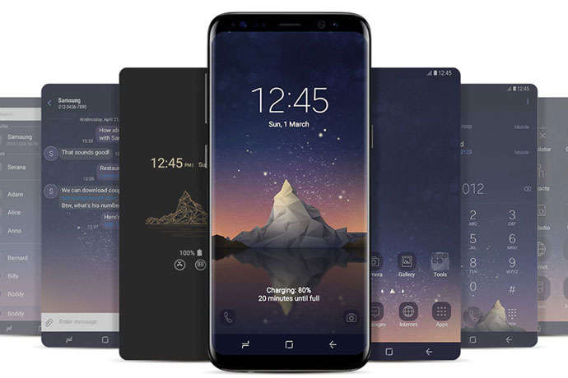
Data

Slide 7

Customer Age
Phone Price
Brand Rating
Exchange Policy
Suggestion to Other User
Customer Gender
Mode of buying
Inducing factor
Previous & Current Phone Brand
Feature & Accessory
Next Phone purchase
Current Phone Duration

Slide 8

Market Brand Positioning

Slide 9

Total No of Brands = 15
Total No of Customers = 47
Xiaomi Customers = 12
Probability that a potential customer will buy xiaomi = 0.26
Inferential probability statistics to determine potential no of Xiaomi Customers

Slide 10

BRAND PREFERENCE
Customer & Mobile
Features
Brand
Customer Age
Customer Gender
Affordable Price
Preferred Feature
Mode of buying
Inducing factor
Exchange Policy

Slide 11
Model Building
Data Aggregation, Data Transformation
Naïve Bayes(Split,Train,Test)
Evaluation of Model Summary
Parameter Tuning
Model Accuracy metrics
Naïve Bayes
With Cross validation
0.15
0.40
0.66
Random Forest
With Cross validation
0.66

Slide 12

Current Brand | Previous Brand
Lenovo | Oneplus Old
Apple | Apple Old
Xiaomi | Xiaomi Old
Xiaomi | samsung Old
Nokia | Nokia Old
samsung | samsung Old
Oneplus | LG old
LG | HTC Old
samsung | SONY old
Motorola | Nokia Old
samsung | LYF old
Motorola | Micromax old
Motorola | Motorola Old
Oppo | Lenovo old
Xiaomi | LG old
Nokia | samsung Old
samsung | Apple Old
Xiaomi | Apple Old
huawei | Lenovo old
Xiaomi | Xiaomi Old
Apple | Apple Old
Motorola | Motorola Old
Asus | Honor old
honor | blackberry old
Xiaomi | Xiaomi Old
Xiaomi | Motorola Old
Vivo | samsung Old
Realme | Asus old
Xiaomi | Xiaomi Old
Nokia | Motorola Old
Apple | Xiaomi Old
HTC | HTC Old
Apple | Xiaomi Old
Xiaomi | Micromax old
Apple | Xiaomi Old
Xiaomi | Xiaomi Old
Apple | Apple Old
samsung | Nokia Old
samsung | samsung Old
samsung | Xiaomi Old
Xiaomi | Xiaomi Old
LG | Nokia Old
Motorola | microsoft old
samsung | Oneplus Old
Oneplus | Oneplus Old
Apple | Apple Old
Xiaomi | Xiaomi Old
Current Brand & Previous Brand

Slide 13
Model Building
Data Transformation
Apriori Algorithm
Define Support, Confidence
Parameter Tuning
Identify Frequent Brand Pattern

Slide 14

Model Building to identify Frequent Brand Preference
Apriori Algorithm
Rule: Apple Old -> Apple
Support: 0.0851063829787234
Confidence: 0.5714285714285714
Lift: 4.476190476190476
=============================
Rule: Xiaomi -> Xiaomi Old
Support: 0.14893617021276595
Confidence: 0.5833333333333334
Lift: 2.4924242424242427

Slide 15
LOYAL CUSTOMERS
Rule: Apple Old -> Apple
Support: 0.0851063829787234
Confidence: 0.5714285714285714
Lift: 4.476190476190476
=============================
Rule: Xiaomi -> Xiaomi Old
Support: 0.14893617021276595
Confidence: 0.5833333333333334
Lift: 2.4924242424242427
Current Brand | Previous Brand | Loyal
Apple | Apple | Loyal
Xiaomi | Xiaomi | Loyal
Nokia | Nokia | Loyal
samsung | samsung | Loyal
Motorola | Motorola | Loyal
Xiaomi | Xiaomi | Loyal
Apple | Apple | Loyal
Motorola | Motorola | Loyal
Xiaomi | Xiaomi | Loyal
Xiaomi | Xiaomi | Loyal
HTC | HTC | Loyal
Xiaomi | Xiaomi | Loyal
Apple | Apple | Loyal
samsung | samsung | Loyal
Xiaomi | Xiaomi | Loyal
Oneplus | Oneplus | Loyal
Apple | Apple | Loyal
Xiaomi | Xiaomi | Loyal
Row Labels | Count of Current Brand
Xiaomi | 7
Apple | 4
samsung | 2
Motorola | 2
HTC | 1
Oneplus | 1
Nokia | 1
Grand Total | 18

Slide 16



Life of a phone
Classifying the lifetime usage of a mobile phone by a customer as sum of current phone holding duration & next phone purchase time period
Age Analysis
Gender Analysis
Middle age group have a lesser frequency of changing their phones.
To launch a new phone, the target group could be the adult and young adult
Females(15) have a smaller lifetime of mobile phones. So we could say that they tend to change their mobile phones more frequently than the male customers

Slide 17
Product Launch
Marketing Strategy
Right Product Mix
Right Time
Right Customers
****Target customer, Preference, Market Analysis (Competition & Chain Customers) Powered by Analytics

